Slide 1


Smart Expense Tracker with NLP-Based Query Detection
Done by:
Gitanjali J (221801012)
Jotheswari P (221801022)

Slide 2

Problem Statement
In the modern digital age, managing personal finances has become increasingly complex, with users facing challenges in tracking expenses, categorizing transactions, and planning budgets effectively.
Most existing financial tools offer limited automation and require manual input, making them inefficient and time-consuming.
Moreover, they often lack personalized insights and intelligent analysis to support informed decision-making.

Slide 3
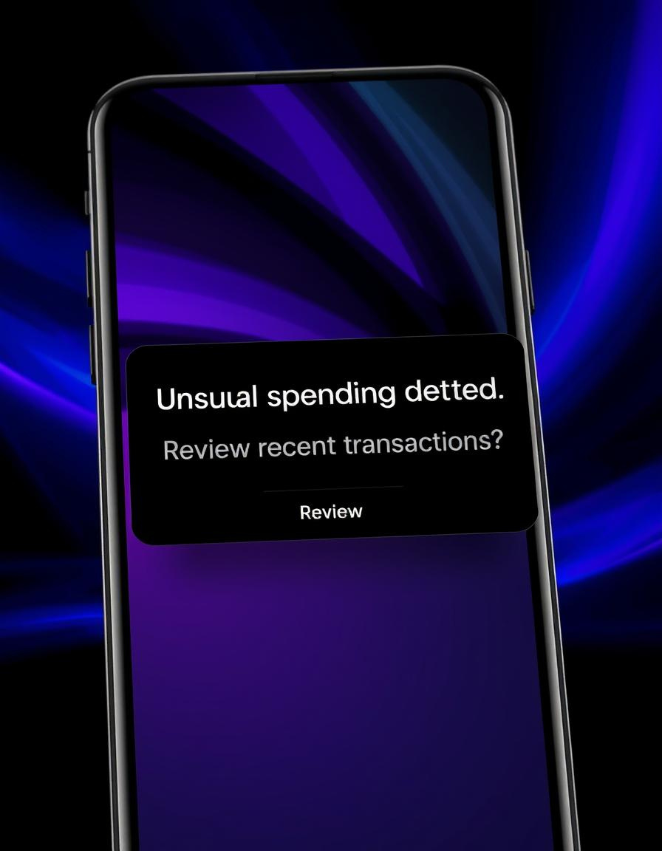
Objectives
To develop a user-friendly expense tracker that automates the categorization of receipts and transactions using Natural Language Processing (NLP).
To implement Machine Learning algorithms for predicting future financial trends based on historical spending data.
To provide personalized budget recommendations tailored to individual user behavior and financial goals.
To ensure data privacy and security while offering a seamless and intuitive user experience.
To help users optimize their expenses and improve overall financial literacy and management.

Slide 4

Abstract
The platform tracks and categorizes personal expenses.
It utilizes machine learning to predict future financial trends.
NLP is used for seamless categorization of receipts and transactions.
Personalized budget recommendations are provided based on user behavior.
Users receive a financial health score for better insights.
Irregular spending patterns are flagged through anomaly detection.
The platform helps users optimize their spending and make informed financial decisions.

Slide 5

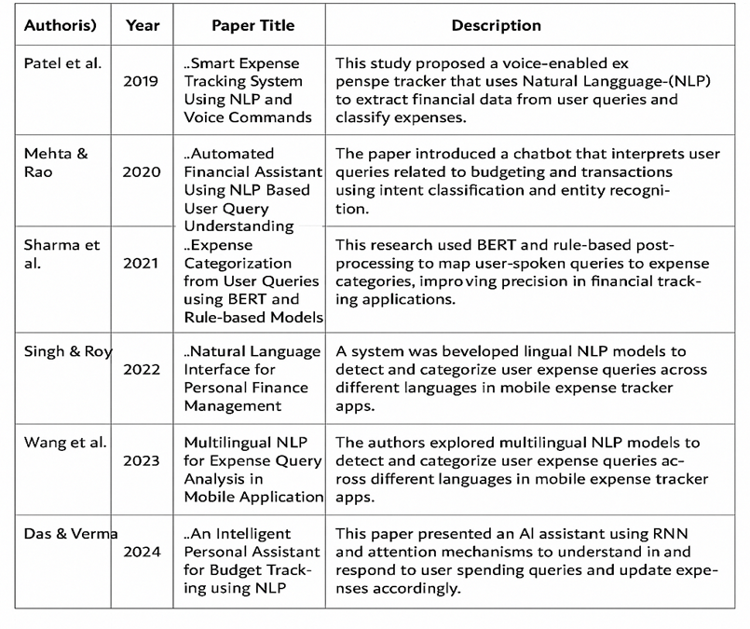
Literature survey

Slide 6
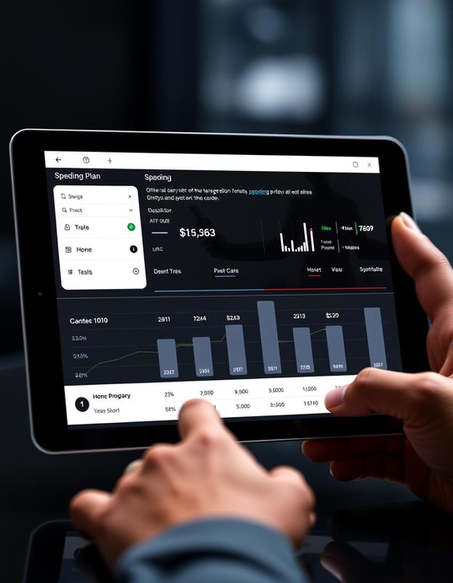
Existing system
These tools help individuals and businesses manage their finances, track spending, categorize transactions, and provide insights into financial health, with some offering advanced features like budgeting, AI predictions, and expense forecasting.
Mint (by Intuit)
Mint is a widely used personal finance management tool.
It tracks expenses, creates budgets, and provides financial insights.
AI/Automation: Mint uses machine learning for automatic transaction categorization and financial insights based on user spending patterns.
Pocket Guard
PocketGuard helps users track their spending and save money.
AI/Automation: Uses predictive algorithms to calculate how much money users can safely spend after considering upcoming bills and savings goals.

Slide 7

Drawbacks of existing system
Limited Personalization: Budgeting and insights are often generic and not tailored to individual user behavior
No Natural Language Support: Users cannot interact with the system using natural language queries
Lack of Predictive Analysis: Most tools focus on historical tracking without predicting future financial trends or offering proactive recommendations.
Weak Anomaly Detection: Irregular or suspicious spending patterns are not effectively identified or flagged in real time.

Slide 8
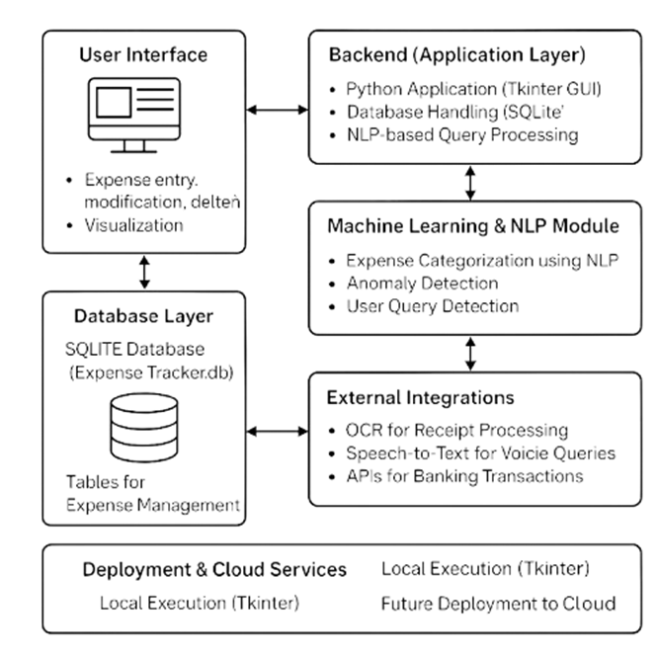
System Architecture

Slide 9
Proposed System
Personalized Budgeting and Insights: Uses machine learning to analyze user behavior and provide tailored financial advice and budget recommendations.
Natural Language Query Support: Enables users to interact with the system using simple natural language, making it more user-friendly and accessible.
Predictive Financial Trend Analysis: Employs ML models to forecast future expenses and financial trends, helping users plan ahead effectively.
Anomaly Detection for Spending Patterns: Identifies and flags irregular or suspicious transactions, promoting better financial awareness and control.

Slide 10
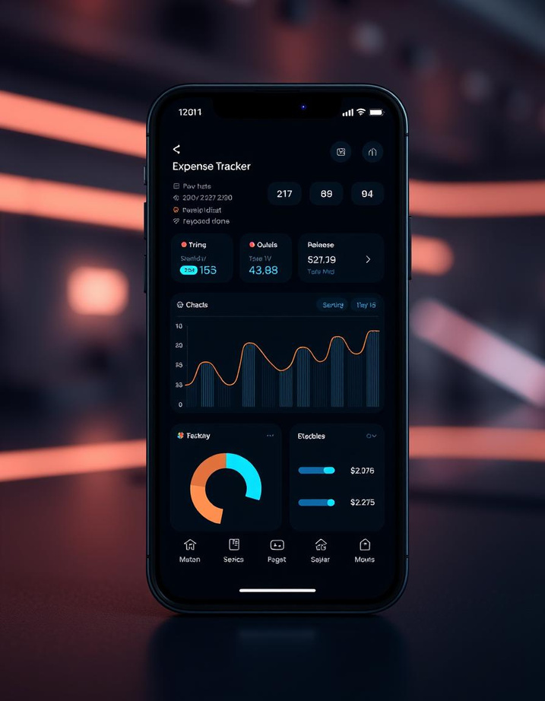
Techonology Used
Programming Language
Python: Core language for implementing logic, NLP, database handling, and ML.
Database
SQLite (.db file): Lightweight, serverless database used for storing expense records, user data, and categories.
Natural Language Processing (NLP)
NLTK / spaCy / Transformers: For understanding user queries, intent recognition, and entity extraction.
Graphical User Interface (GUI)
Tkinter: For building a simple desktop GUI interface.
Others
datetime / calendar: For handling time-based queries and reports.

Slide 11
Modules
User Registration Module:Used for users to register the application for personalized experience
Data Storage Module:Used to store the data/expenses of the user
Expense Tracking Module:Tracks expenses of the user and gives customized results
Natural Language Procseeing Module:Used for user querry detection in the form of a chatbot

Slide 12
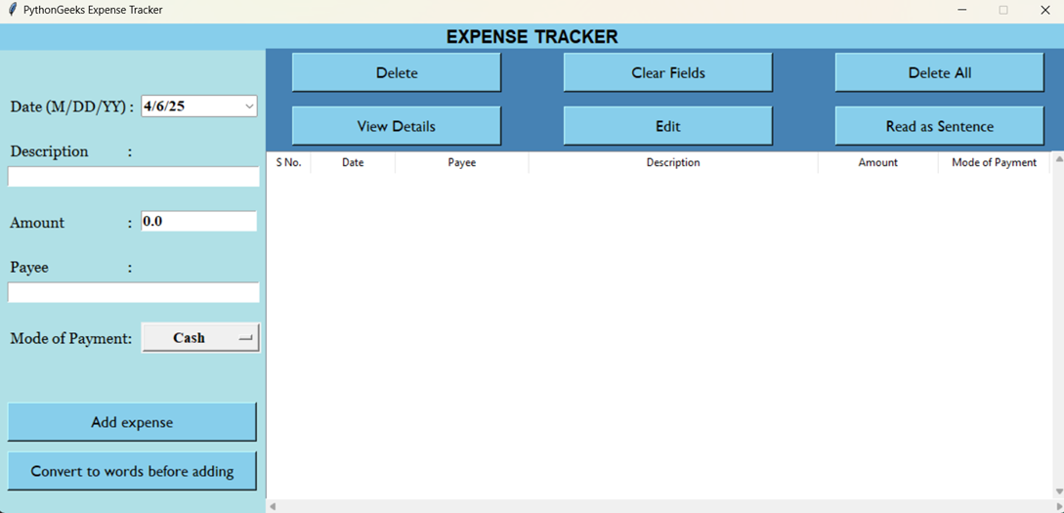
Output
Expense Tracker

Slide 13
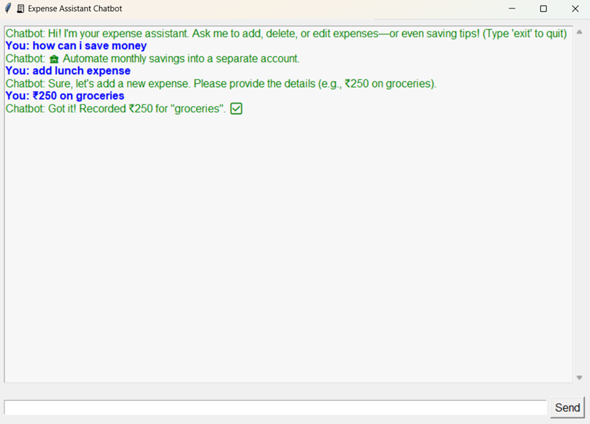
Output
User Query Application

Slide 14
Conclusion
The integration of Natural Language Processing (NLP) into expense tracking systems represents a significant advancement in personal finance management. Users can interact with their expense trackers more intuitively and efficiently, using natural language queries instead of complex interfaces or manual data entry.
This ease of use greatly enhances user engagement and allows for a more seamless experience when tracking daily expenses and obtaining financial insights.The application of NLP can enhance the accuracy and efficiency of expense categorization. Traditional expense tracking systems often rely on manual input or basic rule-based algorithms, which can lead to errors or inefficiencies.
However, by employing NLP techniques such as text analysis and intent detection, expense trackers can automatically categorize transactions with a higher level of precision.

